Slide 1
1

Slide 2
2

Slide 3
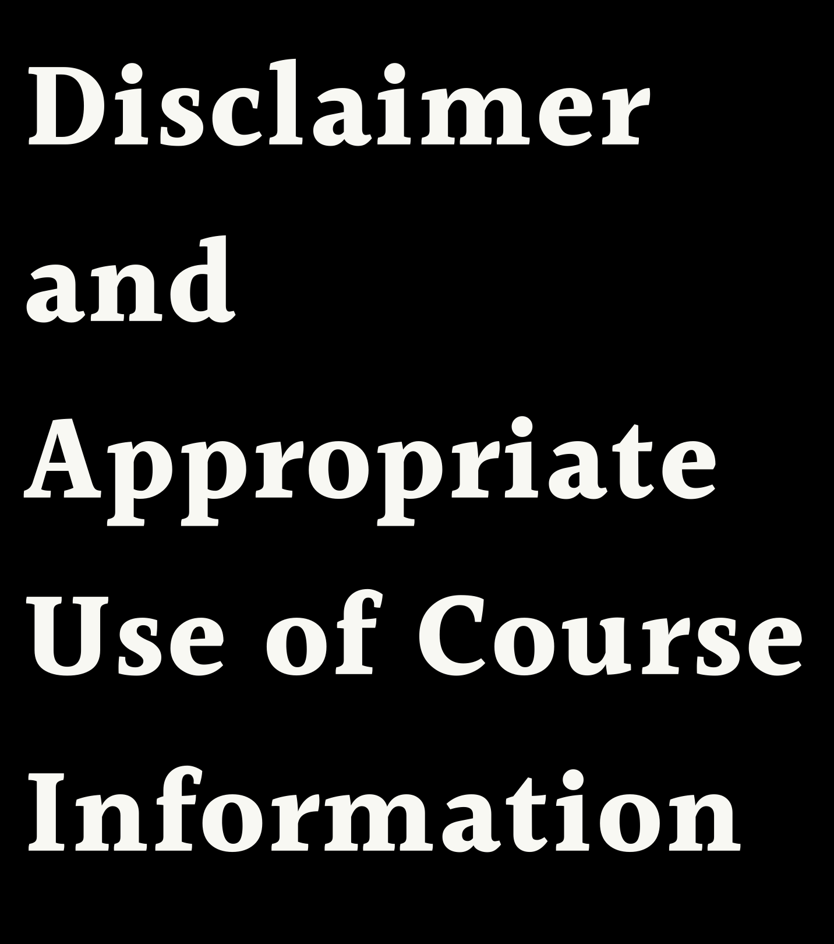
The content and instruction made throughout this course are provided solely for reference and educational purposes to students, traders, and analysts (Participants).
By participating in this course, you agree that all trading or investment decisions made by Participant are at the sole risk to the Participant and Participant assumes all responsibility for any and all decisions made in financial markets.
By taking this course, you also acknowledge that trading in financial markets involves risk of loss as well as the potential for gains. As a student, trader, or investor, you agree to assume all responsibility for any and all actions you initiate in financial markets, and neither the authors, instructors, or publishers affiliated with this course, or anyone whose work is cited or referenced in the course, assumes any liability whatsoever for your decisions.
Futures or options trading are considered high risk. Information provided in the MMTA course or MMA publications is provided with sincere intent, and according to MMA’s own proprietary and copyrighted processes and methodologies. All content and information provided is the intellectual property of MMA and MMTA developed by Raymond Merriman and his 40+ years of experience, observation, and research.
Students may use this material responsibly and solely for their own trading and investment planning. They may cite brief sections of these studies with proper credit to MMA or MMTA. However, any other reproduction or use of this copyrighted material must be with the written consent of MMA.
3
Notes:
MMTA Course One – Cycles and Chart Patterns in Financial Markets

Slide 4
THE PURPOSE OF THIS LESSON IS TO LEARN A VARIATION OF A
TREND RUN UP AND A
TREND RUN DOWN
4
Notes:
The purpose of this lesson is to understand and identify cases of an “On Edge Trend Run Down” and “On Edge Trend Run Up.”

Slide 5
In this lesson, you will learn the following:
Criteria for “On edge, Trend Run” up/down
Pauses in a Trend Run
5
Notes:
In this lesson, you will learn:
The criteria for an “On Edge, Trend Run Up”
The criteria for an “On Edge, Trend Run Down”
Pauses in a Trend Run

Slide 6
“ON EDGE, TREND RUN UP”
M A R K E T C A N U P G R A D E F R O M
NE U T R A L I F I T C L O S E S A B O V E T H E T I P A ND A T A NE W C Y C L E H I G H
A T L E A S T A B O V E T R A D I NG C Y C L E
H I G H , B E T T E R I F M A J O R C Y C L E H I G H
O NL Y O N F I R S T O R S E C O ND D A Y A B O V E T I P
“ O N E D G E , T R E ND R U N U P ” = A S B U L L I S H A S 3 R D D A Y T I P
C A N B E F U R T H E R U P G R A D E D T O F U L L T R E ND R U N U P
O NL Y D O W NG R A D E D B A C K T O
NE U T R A L I F C L O S E S B E L O W T I P O R S U P P O R T
6
Notes:
A market can be upgraded from neutral even when it hasn’t closed three consecutive days above the TIP. For instance, the market might have such a powerfully strong rally that it closes not just above the TIP, but also above the high of at least the trading cycle. It is better if it is above the last major cycle high. It forms a new cycle high on a powerful up day. However, it is only the first or second day above the TIP. In this case, the TIP may be upgraded from neutral to “on edge, trend run up.” For all intents and purposes, an “on edge trend run up” is just as bullish as the third day up that creates a trend run up status. In fact, it is even more so because the market has closed at a new multi-week high, so it has momentum clearly in its favor.
When it exhibits three closing days above the TIP, and the third day is also an up day, it can be upgraded further to a trend run up, from an “on edge, trend run up.”
If the next day is a close down, then the “on edge, trend run up” status is either downgraded to neutral if it is below TIP or daily support, or can remain as an “on edge, trend run up,” if the close remains above TIP. If the close is below support, it could mean that the big rally was a fake out.

Slide 7
“ON EDGE, TREND RUN DOWN”
M A R K E T C A N D O W NG R A D E F R O M NE U T R A L I F I T C L O S E S B E L O W T H E T I P A ND A T A NE W C Y C L E L O W
A T L E A S T B E L O W T R A D I NG C Y C L E L O W , B E T T E R I F M A J O R C Y C L E L O W
O NL Y O N F I R S T O R S E C O ND D A Y B E L O W T I P
“ O N E D G E , T R E ND R U N D O W N” = A S B E A R I S H A S 3 R D D A Y T I P
C A N B E F U R T H E R D O W NG R A D E D T O F U L L T R E ND R U N D O W N
O NL Y U P G R A D E D B A C K T O
NE U T R A L I F C L O S E S A B O V E T I P O R R E S I S T A NC E
7
Notes:
A market can be downgraded from neutral even when it hasn’t closed three consecutive days below the TIP. For instance, the market might have such a powerfully strong decline that it closes not just below the TIP, but also below the low of at least the current trading cycle so far. It forms a new cycle low on a powerful down day, although it is only the first or second day below the TIP. In this case, we can downgrade the TIP from neutral to “on edge, trend run down.”
When it exhibits three closing days below the TIP, and the third day is also a down day, it can be downgraded further to a trend run down, from an “on edge, trend run down.” This is a strong sign that the trend status is changing and just as powerful as a trend run down in most cases.
If the next day is a close up, then the “on edge, trend run down” status is either upgraded to neutral if it is above TIP or resistance, or it can remain as an “on edge, trend run down” if the close remains below TIP or resistance. If the close is above resistance, it could mean that the big decline was a fake out.

Slide 8
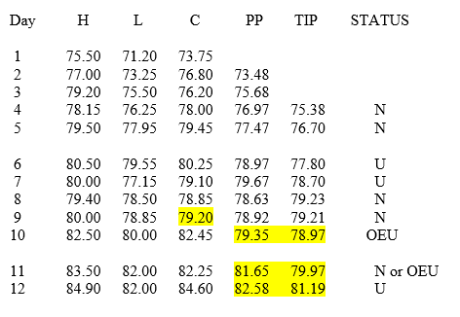
EXAMPLE
8
Notes:
Let’s assume the highest price in a market cycle so far has been 80.50. After reaching that high, it pulls back for a couple of days and closes below the daily TIP for two consecutive days. It is neutral. The next day it trades much higher and closes above the 80.50 high of the cycle prior to that time. The close is above the daily TIP for the first time in three days. Normally this would still be considered a neutral status, for it hadn’t closed above TIP for three straight days. However, the rally was so strong it made a new cycle high and closed near the high. In such a case, the status is greater than no change, or neutral. We will consider it an “on edge, trend run up,” to reflect the reality that it is making a new cycle high.
The next day might be a lower close, but still above the TIP. If so, it would either be downgraded back to neutral or remain in an “on edge, trend run up,” depending on the close. However, if the next day is a close up and again above TIP, it is upgraded to a full trend run up.

Slide 9
PAUSES IN A TREND RUN
W H E N M A R K E T C L O S E S R I G H T A T T I P , T R E ND S T A T U S
R E M A I NS I NT A C T
H O W E V E R , A W A R NI NG T H A T T R E ND C O U L D C H A NG E S O O N
I F M A R K E T I N T R E ND R U N U P , A ND NE X T D A Y C L O S E S O N T I P , I T R E M A I NS U P
B U T I F NE X T D A Y I S B E L O W T I P , I T D O W NG R A D E S T O
NE U T R A L
I F NE X T D A Y I S D O W N A ND B E L O W T I P , I T D O W NG R A D E S T O T R E ND R U N D O W N
9
Notes:
There will be cases where a market closes right on the TIP. In these cases, the status of the trend (trend run up, down, or neutral) that was in effect remains intact. This is a warning that a trend run up or down may be about to change.
For example, if the market has been in a trend run up, and then the close of the current day is exactly on the TIP, it remains in a trend run up. If on the next day it closes below the TIP, it reverses from trend run up to neutral. Furthermore, this means that the market has not closed above the TIP for two consecutive days. If the next day is a down day and also below the TIP, it will be downgraded from neutral to trend run down.

Slide 10
QUIZ #11
“ O N E D G E ” T R E ND
R U NS U P A ND D O W N
Notes:
QUIZ #11
“ON EDGE” TREND RUNS UP AND DOWN

Slide 11
What is an “on edge” trend run up? What is an “on edge” trend run down?
When does an “on edge” trend run down become a full trend run down?
What constitutes a “pause” in a trend run up or down? What does it warn?
Please label the trend status for each day in the following example, which assumes the trading cycle low was 71.20. Also calculate the PP and TIP

Slide 12
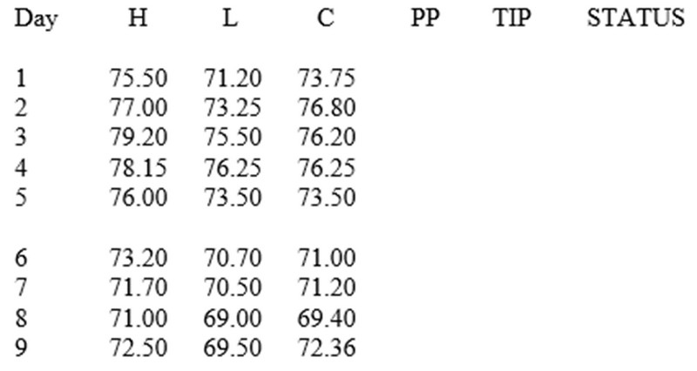

Slide 13
End of Module Lesson Eleven: “On Edge” Trend Runs Up And Down
BREAK

